Slide 1
Logistic Regression Model
Simplified Cost function and Gradient Descent
Cost function
Advanced Optimization

Slide 2
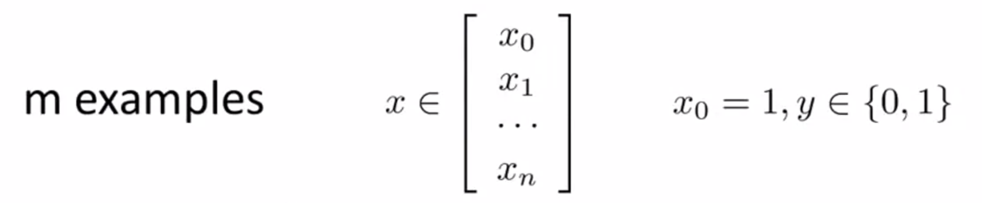
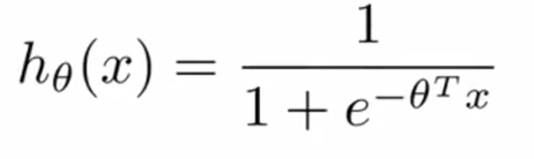
Cost function

Slide 3
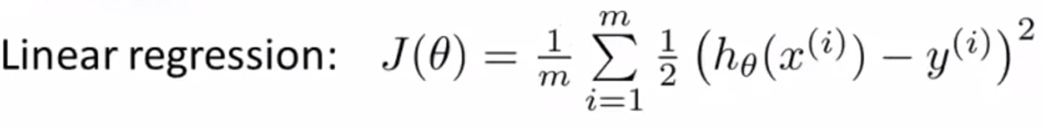
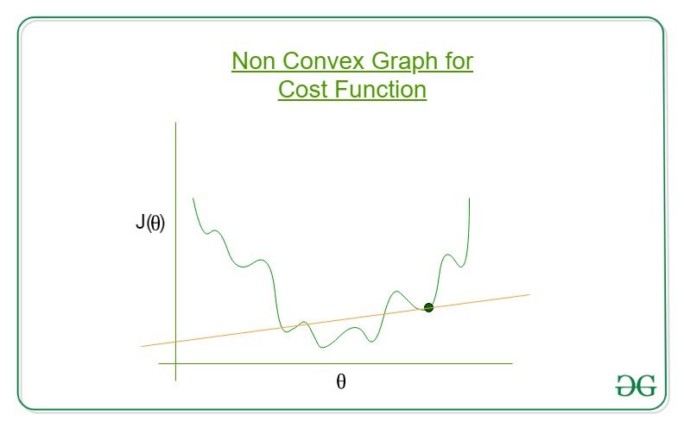
Cost function
Cost function

Slide 4

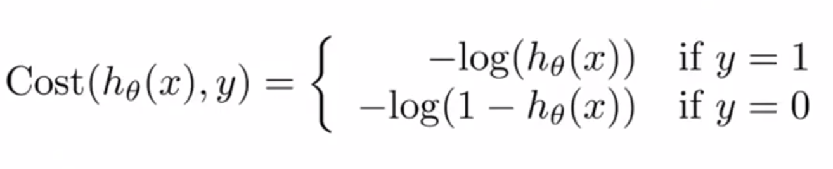
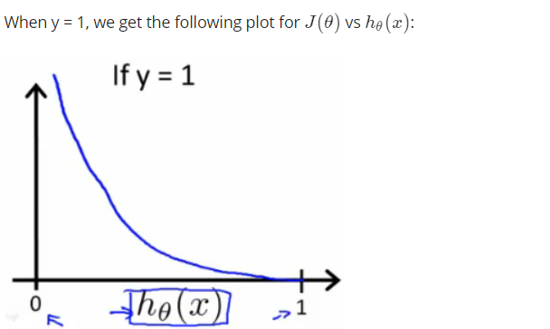
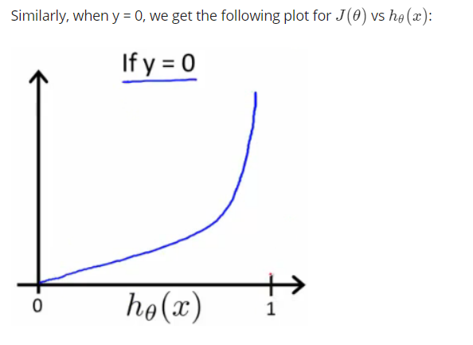
Simplified Cost function and Gradient Descent
Cost function

Slide 5

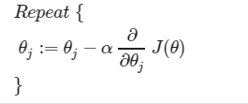
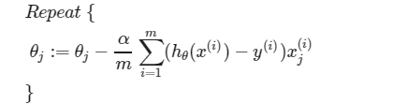
Simplified Cost function and Gradient Descent
Cost function for logistic regression
Gradient descent
We can work out the derivative part using calculus to get

Slide 6
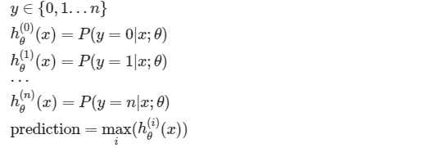
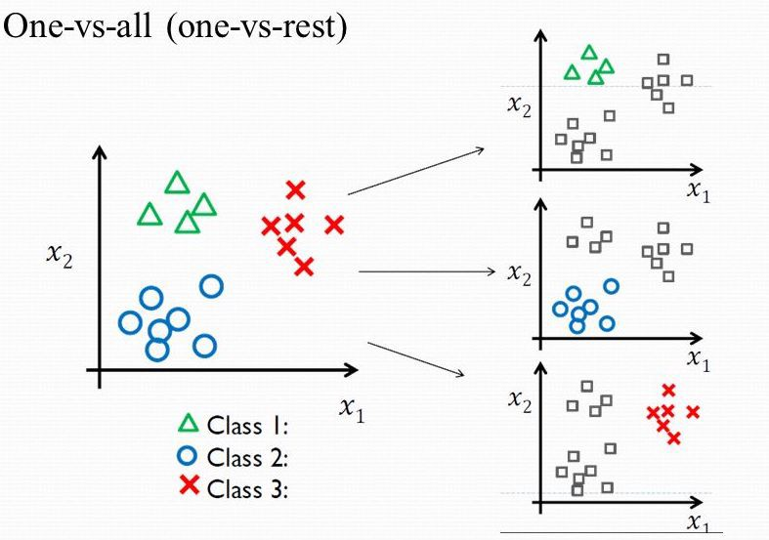
Multiclass Classification
Now we will approach the classification of data when we have more than two categories. Instead of y = {0,1} we will expand our definition so that y = {0,1...n}.
One vs all

